Slide 1
Recursions and Dynamic Programming
Il-Chul Moon Dept. of Industrial and Systems Engineering KAIST
icmoon@kaist.ac.kr

Slide 2
Weekly Objectives
This week, we learn how to program recursive routines and dynamic programming concepts
Recursion
Dynamic programming
Objectives are
Understanding the concept of recursions
Repeating problems
Divide and conquer
Recursion function call
Recursion escape
Recursion depth
Able to implement recursive programs
Understanding the concept of dynamic programming
Reusing previous function call result
Memoization for time saving

Slide 3
Recursion

Slide 4

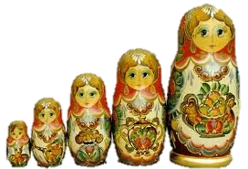
Repeating Problems and Divide and Conquer
Calculating a budget of a company?
Departments consist of the company
Departments within departments
Can’t avoid the below structures
class Department
dept = [sales, manu, randd]
def calculateBudget(self)
Sum = 0
For itr in range(0, numDepartments)
Sum = sum + dept[itr].calculateBudget()
Return sum
Budget
600M won
Company A
Budget
100M won
Budget
300M won
Budget
200M won
Sales Dept.
Manufacturing Dept.
R&D Dept.
Russian Doll:
Dolls within dolls
Budget
10M won
Seoul Sales Branch
Busan Sales Branch
Daejeon Sales Branch

Slide 5
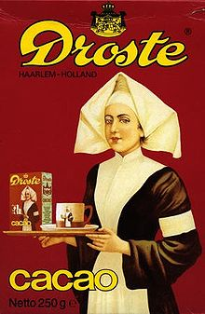
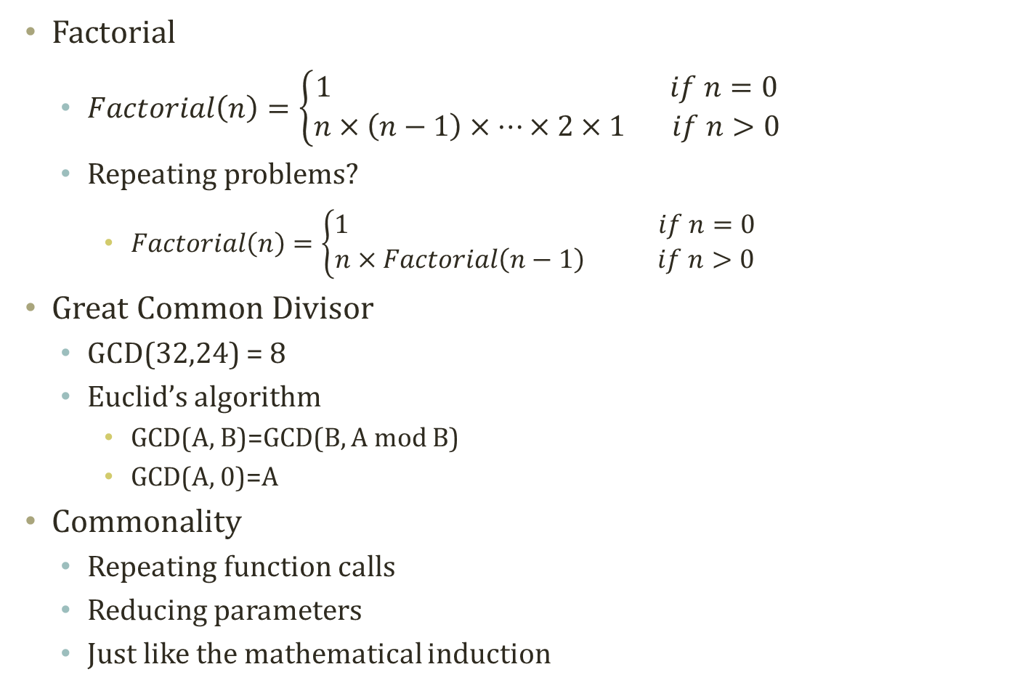
More examples…
Factorial
$Factorial\left(n\right)=\left\{\begin{aligned}1 if n=0 \\ n×\left(n−1\right)×…×2×1 if n>0\end{aligned}\right.$
Repeating problems?
$Factorial\left(n\right)=\left\{\begin{aligned}1 if n=0 \\ n×Factorial\left(n−1\right) if n>0\end{aligned}\right.$
Great Common Divisor
GCD(32,24) = 8
Euclid’s algorithm
GCD(A, B)=GCD(B, A mod B)
GCD(A, 0)=A
Commonality
Repeating function calls
Reducing parameters
Just like the mathematical induction
Self-Similar

Slide 6
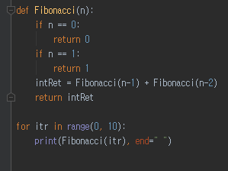
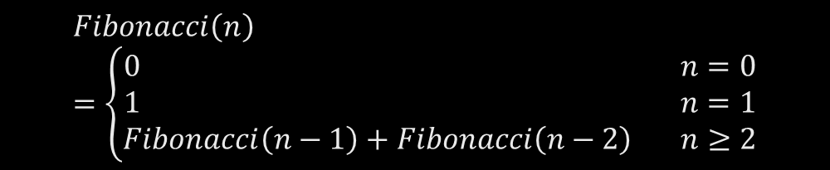
Recursion
A programming method to handle the repeating items in a self-similar way
Often in a form of
Calling a function within the function
def functionA(target)
….
functionA(target’)
….
if (escapeCondition)
Return A;
Program Execution Flow
F(4)
F(3)
F(2)
F(2)
F(1)
F(1)
F(1)
F(0)
F(0)
$$Fibonacci\left(n\right)=\left\{\begin{aligned}0 n=0 \\ 1 n=1 \\ Fibonacci\left(n−1\right)+Fibonacci\left(n−2\right) n≥2\end{aligned}\right.$$

Slide 7
Recursions and Stackframe
Recursion of functions
Increase the items in the stackframe
Stackframe is a stack storing your function call history
Push: When a function is invoked
Pop: When a function hits return or ends
What to store?
Local variables and function call parameters
F(4)
F(3)
F(2)
F(2)
F(1)
F(1)
F(1)
F(0)
F(0)
n
1
n
0
R.A
R.A
n
2
n
2
n
2
R.A
R.A
R.A
n
3
n
3
n
3
n
3
R.A
R.A
R.A
R.A
n
4
n
4
n
4
n
4
n
4
R.A
R.A
R.A
R.A
R.A

Slide 8
Merge Sort
Merge sort: One example of recursive programming
Decompose into two smaller lists
Aggregate to one larger and sorted list
MergeSort(3,8,4,2,1,6,7,5)
Decom-position
Phase
3 | 8 | 4 | 2 | 1 | 6 | 7 | 5
MergeSort(3,8,4,2)
MergeSort(1,6,7,5)
3 | 8 | 4 | 2
1 | 6 | 7 | 5
MergeSort(3,8)
MergeSort(4,2)
MergeSort(1,6)
MergeSort(7,5)
3 | 8
4 | 2
1 | 6
7 | 5
Turning Point
3
8
4
2
1
6
7
5
Aggre-gation
Phase
3 | 8
2 | 4
1 | 6
5 | 7
2 | 3 | 4 | 8
1 | 5 | 6 | 7
1 | 2 | 3 | 4 | 5 | 6 | 7 | 8

Slide 9
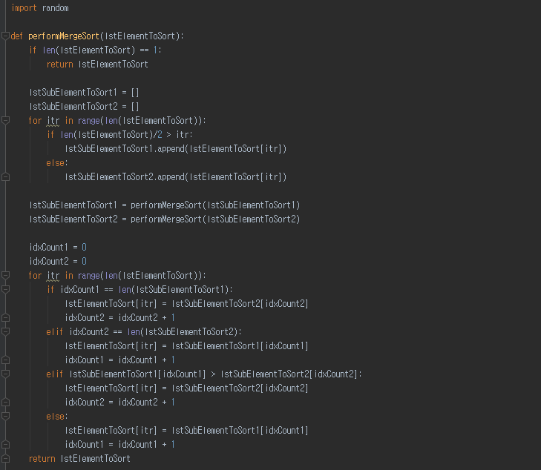
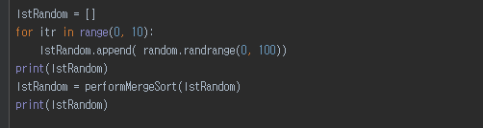

Implementation Example: Merge Sort
Execution Code
Decomposition
Code execution timing!
Before Recursion
= Before Branching out
After Recursion
= After Branching out
Recursion
Aggregation

Slide 10
Problems in Recursions of Fibonacci Sequence
Problems in recursions
Excessive function calls
Calling functions again and again
Even though the function is executed before with the same parameters
For instance, Fibonacci(4)
Has two repeated calls of F(0)
Has three repeated calls of F(1)
Has two repeated calls of F(2)
These are unnecessarily taking time and space
How to solve this problem?
F(4)
F(3)
F(2)
F(2)
F(1)
F(1)
F(1)
F(0)
F(0)

Slide 11
Dynamic Programming

Slide 12
Dynamic Programming
Dynamic programming:
A general algorithm design technique for solving problems defined by or formulated as recurrences with overlapping sub-instances
In this context, Programming == Planning
Main storyline
Setting up a recurrence
Relating a solution of a larger instance to solutions of some smaller instances
Solve small instances once
Record solutions in a table
Extract a solution of a larger instance from the table
F(4)
F(3)
F(2)
F(2)
F(1)
F(1)
F(1)
F(0)
F(0)
Instance | Solution
F(0) | 0
F(1) | 1
F(2) | 1
F(3) | 2
F(4) | ?

Slide 13
Memoization
Key technique of dynamic programming
Simply put
Storing the results of previous function calls to reuse the results again in the future
More philosophical sense
Bottom-up approach for problem-solving
Recursion: Top-down of divide and conquer
Dynamic programming: Bottom-up of storing and building
Stackframe
Memoization
F(4)
Recursion
Instance | Solution
F(0) | 0
F(1) | 1
F(2) | 1
F(3) | 2
F(4) | 3
F(3)
F(2)
Dynamic Programming
n
2
R.A
F(2)
F(1)
n
3
F(1)
F(1)
F(0)
R.A
n
4
F(0)
R.A

Slide 14
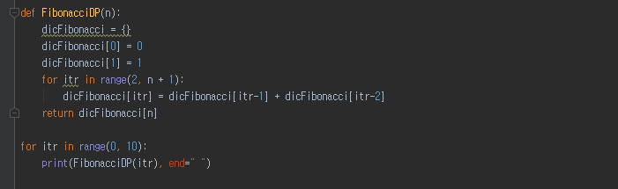
Implementation Example: Fibonacci Sequence in DP
Setting up a memoization table
Building up a bigger solutions
Execution Part
Use a dictionary collection variable type for memoization
Memoization
Storing a fibonacci number for a particular index
Now,
We have a new space requirement, the dictionary or the table, of O(N)
We have reduced execution time from O(2^{n}) to O(N)

Slide 15
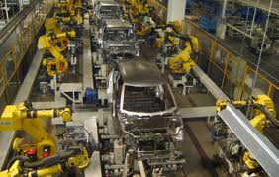
Assembly Line Scheduling
Assembly Line 1
station S_{1,1}
station S_{1,2}
station S_{1,3}
station S_{1,4}
station S_{1,5}
station S_{1,6}
7
9
3
4
8
4
2
1
3
4
3
2
3
Production Start
Production End
2
1
2
2
1
4
2
8
5
6
4
5
7
station S_{2,1}
station S_{2,2}
station S_{2,3}
station S_{2,4}
station S_{2,5}
station S_{2,6}
Assembly Line 2
Goal: Computing the fastest production route

Slide 16
Process of Assembly Line Scheduling
station S_{1,1}
station S_{1,2}
station S_{1,3}
station S_{1,4}
station S_{1,5}
station S_{1,6}
7
9
3
4
8
4
2
1
3
4
3
2
3
Production Start
Production End
2
1
2
2
1
4
2
8
5
6
4
5
7
station S_{2,1}
station S_{2,2}
station S_{2,3}
station S_{2,4}
station S_{2,5}
station S_{2,6}
Assembly Line 2
Time | 1 | 2 | 3 | 4 | 5 | 6
L1 | 9
L2 | 12
Trace | 1 | 2 | 3 | 4 | 5 | 6
L1 | S
L2 | S

Slide 17
Process of Assembly Line Scheduling
station S_{1,1}
station S_{1,2}
station S_{1,3}
station S_{1,4}
station S_{1,5}
station S_{1,6}
7
9
3
4
8
4
2
1
3
4
3
2
3
Production Start
Production End
2
1
2
2
1
4
2
8
5
6
4
5
7
station S_{2,1}
station S_{2,2}
station S_{2,3}
station S_{2,4}
station S_{2,5}
station S_{2,6}
Assembly Line 2
Time | 1 | 2 | 3 | 4 | 5 | 6
L1 | 9 | 18
L2 | 12 | 16
Trace | 1 | 2 | 3 | 4 | 5 | 6
L1 | S | 1
L2 | S | 1

Slide 18
Process of Assembly Line Scheduling
station S_{1,1}
station S_{1,2}
station S_{1,3}
station S_{1,4}
station S_{1,5}
station S_{1,6}
7
9
3
4
8
4
2
1
3
4
3
2
3
Production Start
Production End
2
1
2
2
1
4
2
8
5
6
4
5
7
station S_{2,1}
station S_{2,2}
station S_{2,3}
station S_{2,4}
station S_{2,5}
station S_{2,6}
Assembly Line 2
Time | 1 | 2 | 3 | 4 | 5 | 6
L1 | 9 | 18 | 20
L2 | 12 | 16 | 22
Trace | 1 | 2 | 3 | 4 | 5 | 6
L1 | S | 1 | 2
L2 | S | 1 | 2

Slide 19
Process of Assembly Line Scheduling
station S_{1,1}
station S_{1,2}
station S_{1,3}
station S_{1,4}
station S_{1,5}
station S_{1,6}
7
9
3
4
8
4
2
1
3
4
3
2
3
Production Start
Production End
2
1
2
2
1
4
2
8
5
6
4
5
7
station S_{2,1}
station S_{2,2}
station S_{2,3}
station S_{2,4}
station S_{2,5}
station S_{2,6}
Assembly Line 2
Time | 1 | 2 | 3 | 4 | 5 | 6
L1 | 9 | 18 | 20 | 24 | 32 | 35
L2 | 12 | 16 | 22 | 25 | 30 | 37
Trace | 1 | 2 | 3 | 4 | 5 | 6
L1 | S | 1 | 2 | 1 | 1 | 2
L2 | S | 1 | 2 | 1 | 2 | 2

Slide 20
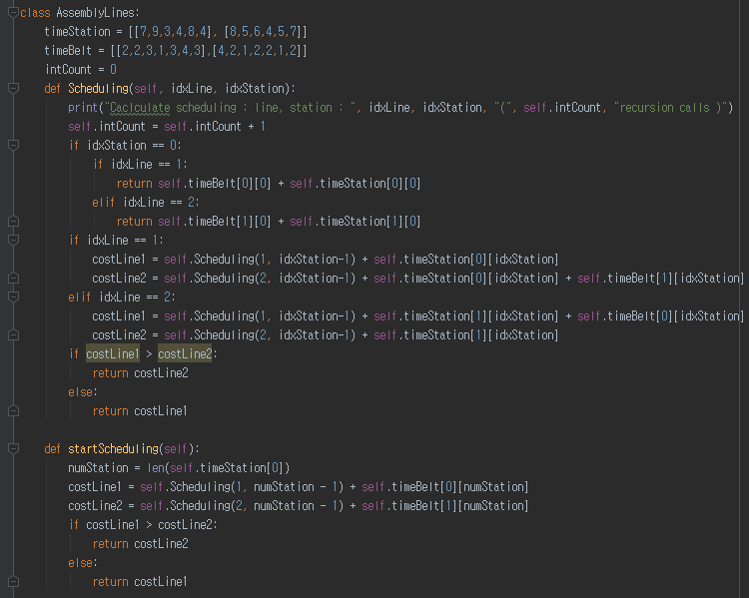


Implementation Example: Assembly Line Scheduling in Recursion
Setting up recursion calls

Slide 21
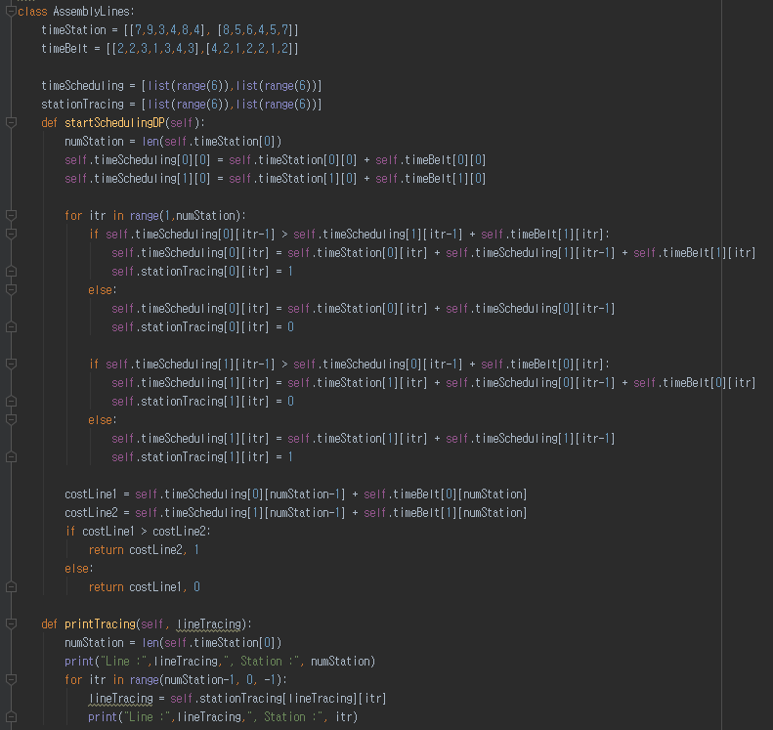


Implementation Example: Assembly Line Scheduling in DP
Setting up
a memoization table
Building up a bigger solutions

Slide 22
Further Readings
Introduction to Algorithms by Cormen et al.
pp. 62-76, 323-356

